Slide 1
Assignment Submission:
AHFAAZ KHAN
25/06/23

Slide 2
Table of Content
Introduction
Question 1
Objective And Assumptions
Executive Summary
Descriptive Statistics
Correlation Plot
PCA Results
Cluster Selection
Kmeans Vs Guassian
Cluster Profiles
Question 2
Objective And Assumptions
Executive Summary
Historical Trend
Descriptive Statistics
Correlation Plot
Model Results
Significant Variables: Model B
Relationship Between External Variables And FFB Yield
Question 3
Results

Slide 3
Introduction
The assignment consists of three questions that need to be answered
Two different data sets have been provided
ingredient.csv –
palm_ffb.csv –
No upfront constraints on the methodology used and assumptions made while analyzing the data
The time period of completion was 5 days ending 24th June, extended by a day to 25th June

Slide 4
Question 1

Slide 5
Objective And Assumptions
Question 1 will be analyzed with an objective to answer the following questions
What is the type, quality, central tendency and spread of the ingredients data
Is there a need to perform steps like data imputation, data standardization, one hot encoding etc. given the information available from i
Is there any correlation between the ingredients and how it can be treated
Are there any meaningful groups into which the formulations can be organized. And how many such groups exist.
What is the best way to organize the formulations into the appropriate groups given information available from ii , iii and iv
Assumptions:
It will be assumed that the potential outliers in the data are meaningful and will not be removed or adjusted. Before any outlier treatment, it is extremely important to understand the reason of its existence by discussing with relevant stakeholders. Simply removing or adjusting the outlier without understanding the reason is as flawed as leaving it untreated.
Missing value imputation also needs business understanding and a detailed data exploration. Because of time constraint, any missing value will be imputed with the average/mode of that variable.

Slide 6
Executive Summary
Important findings
Ingredients a and g and very strong correlated. Moderate correlation also exists between a and e ( Refer “Correlation Plot” slide)
Ingredients h has more than 75% of its values as zero. For the purpose of this analysis, the zero will be considered as genuine values ( Refer “Descriptive Statistics” slide)
Boxplots point toward a lot of outliers in most of the variables. For the purpose of this analysis, they will be left untreated ( Refer “Descriptive Statistics” slide)
There are no missing value in the data and hence no data imputation is needed
Methodology
Because of the variation in units of variables, all the variables have been standardized with mean 0 and standard deviation 1
PCA has been done to treat multicollinearity. 4 PCs that explain 93% of the variance have been selected. ( Refer “PCA Results” slide)
Scree plot was run to select the number of clusters and total 8 cluster were selected. The analysis can be repeated using cluster numbers between 6 and 9 ( Refer “Cluster Selection” slide)
Gaussian mixture model was selected over Kmeans by looking at the shape and size of the clusters. Kmeans prefers speherical and even sized clusters which isn't the case with the formulations ( Refer “Kmeans vs Gaussian” slide)
Results:
8 clusters were generated. The formulation appear to differ on ingredients c, d, f, g, h and i
Ingredients a, b and e are uniform throughout with only minor deviations
Next steps:
Rerun the clustering exercise by understanding the reasons for the existence of the outliers

Slide 7
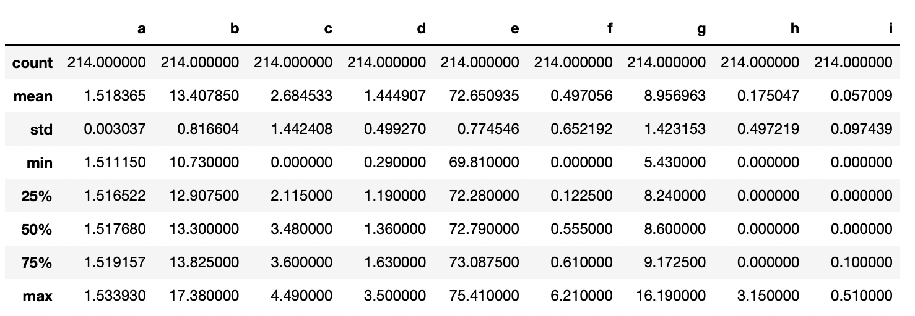
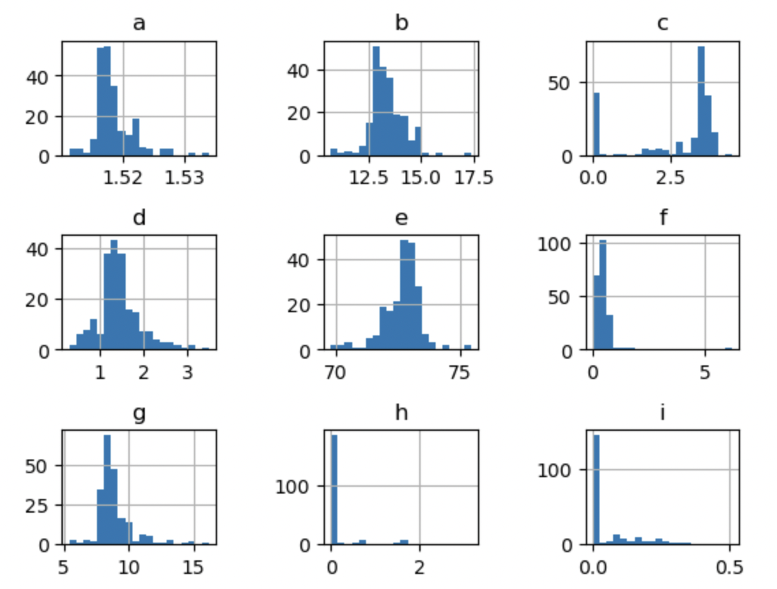
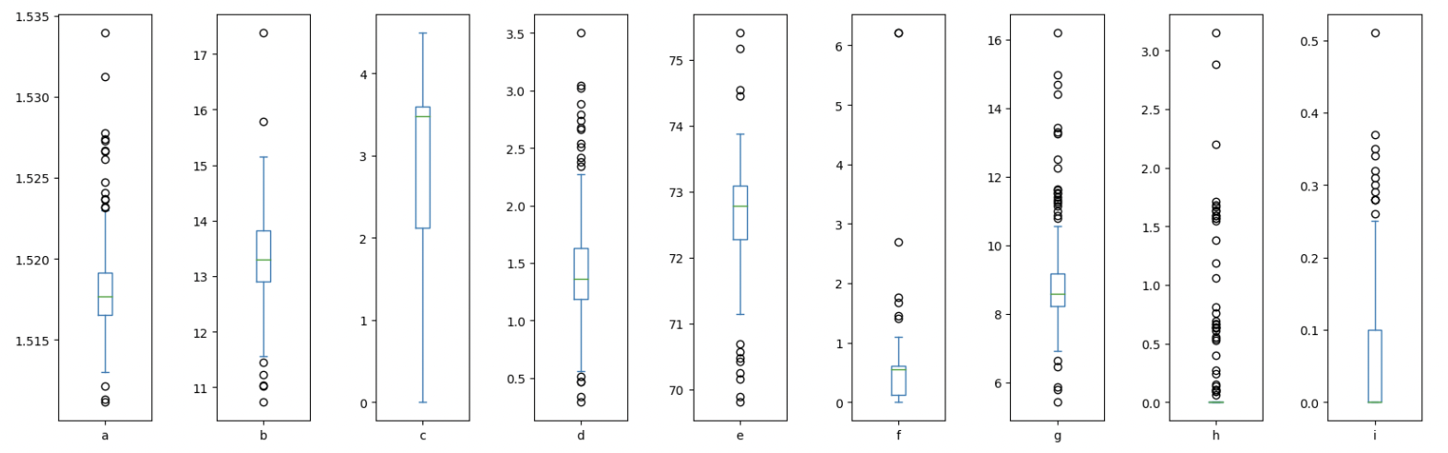
Descriptive Statistics
No missing data
All the variables are continuous
Unit of the variable differ significantly
Ingredient a and g is right skewed and ingredient c in left skewed
Ingredient h and I appear multimodal and need investigation

Slide 8
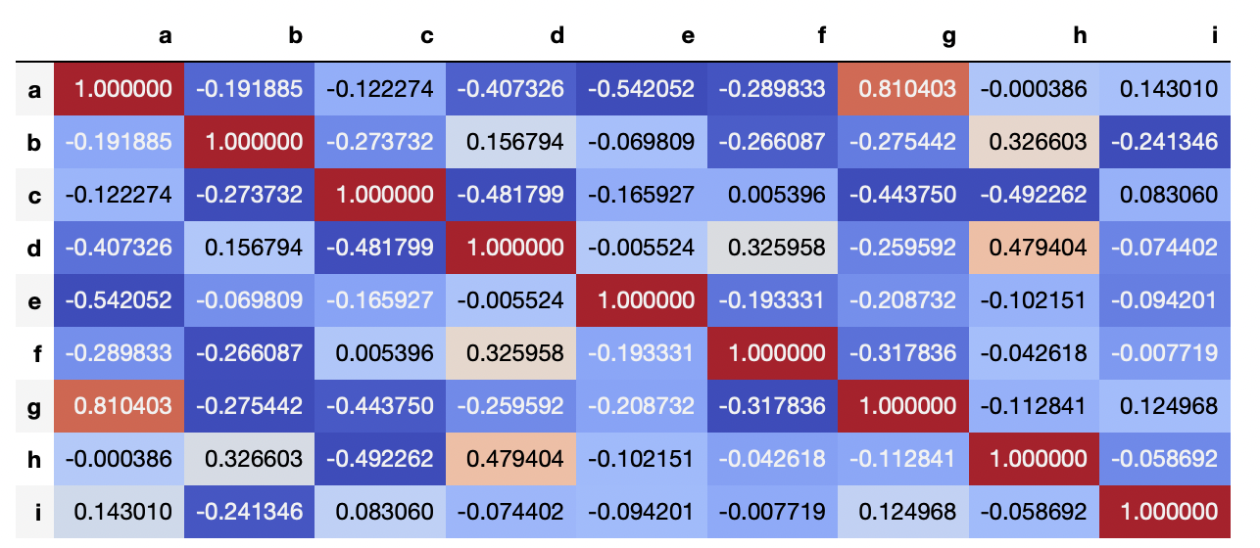
Correlation Plot
Ingredients a and g and very strong correlated
Moderate correlation also exists between a and e

Slide 9
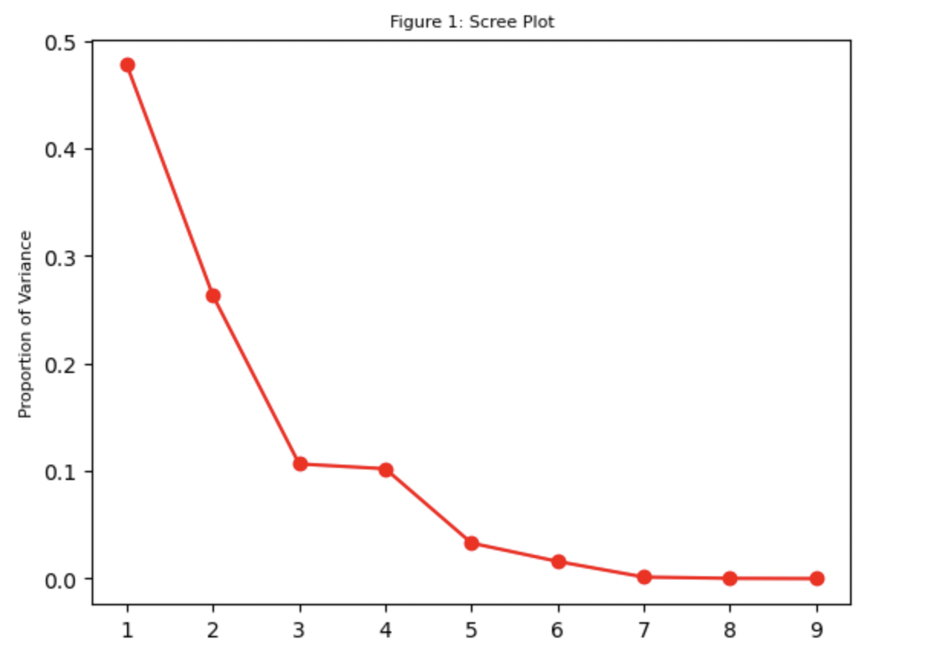
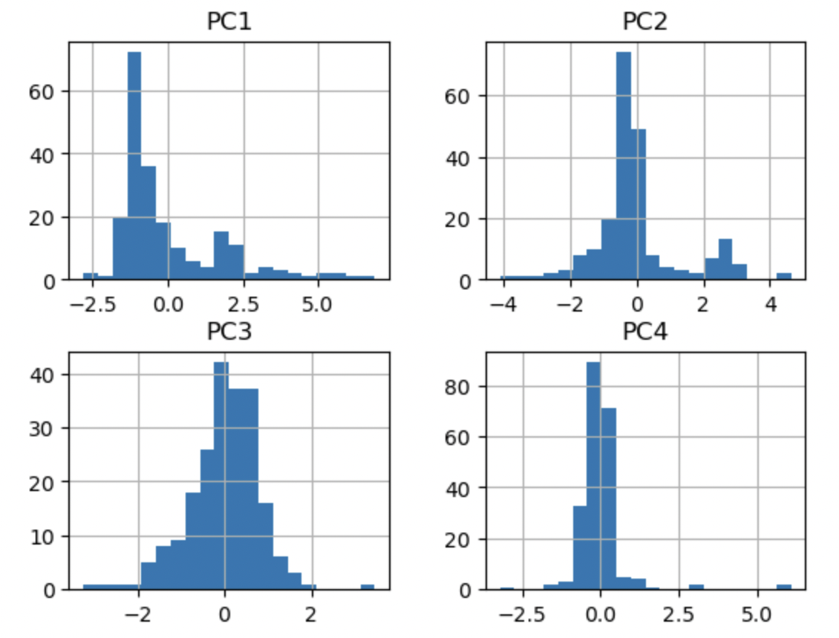
PCA Results
Scree plot
Distribution of 4 principal components
Distribution of ingredients
To smoothen the curve, k-fold sampling can be done
First 4 PCs explain 93% of the variance

Slide 10
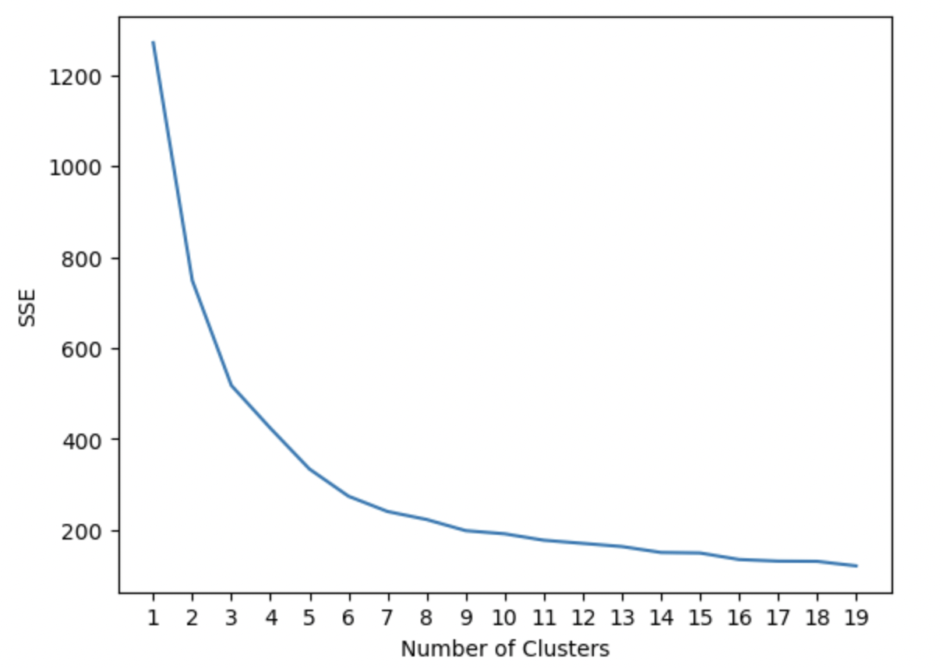
Cluster Selection
The clustering can be done by selecting 6,7,8 and 9 clusters
A good practice is to start on the higher side and validate the results with the stakeholders
Adjustments can be done based on the discussion

Slide 11
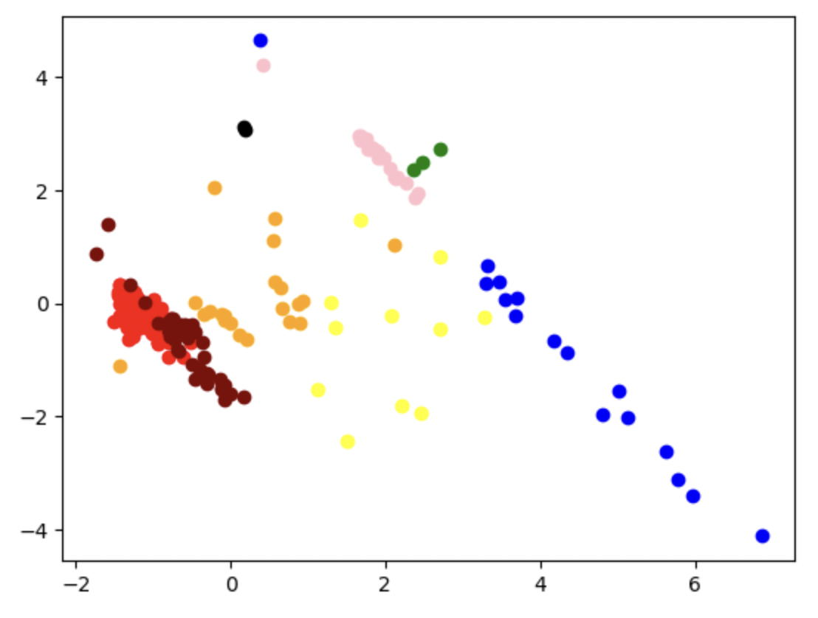
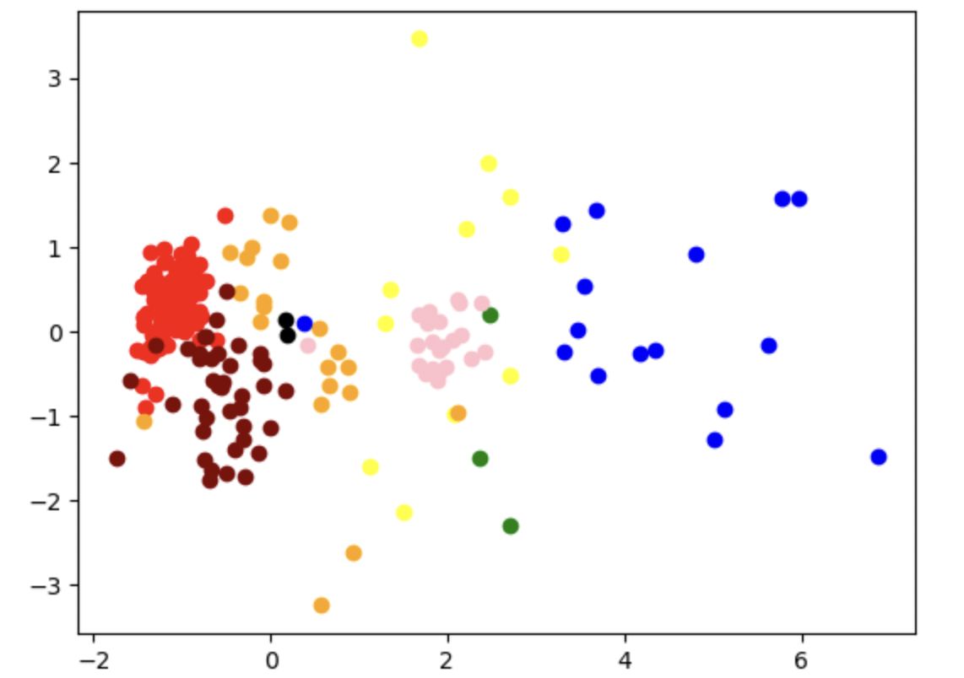
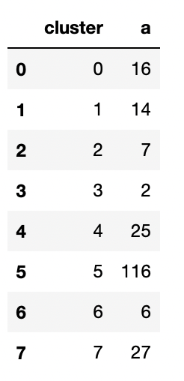
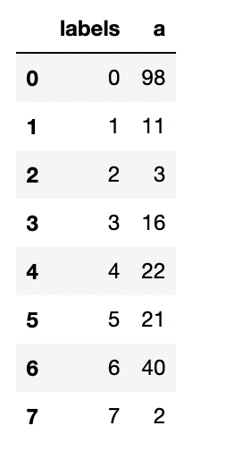
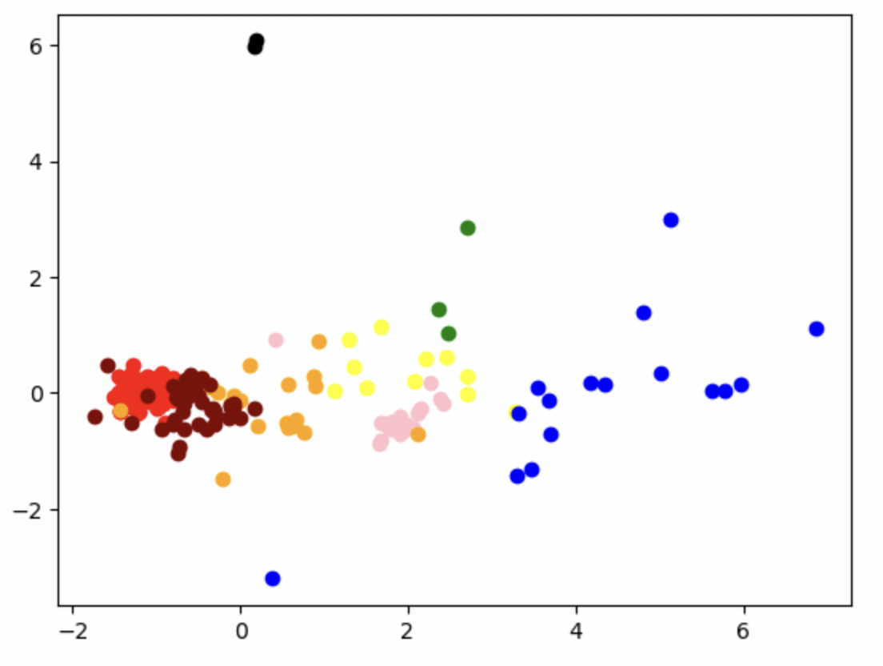
Kmeans vs Gaussian
Cluster size is uneven
Shape of the clusters are non spherical
Cluster size : Kmeans
Cluster size : Gaussian

Slide 12
Cluster Profiles
Cluster labels | a | b | c | d | e | f | g | h | i | Profiles | Size
0 | 1.00 | 0.98 | 1.33 | 0.94 | 1.00 | 1.16 | 0.93 | 0.08 | 1.12 | Over indexed on c and i | 98
1 | 1.00 | 0.90 | 0.29 | 1.06 | 1.02 | 1.94 | 1.19 | 0.00 | 0.98 | no h, underindexed on c and pverindexed on f | 11
2 | 1.00 | 0.98 | 0.00 | 0.86 | 1.00 | 0.56 | 1.35 | 2.02 | 1.07 | no c, underindexed on f and overindexed on h | 3
3 | 1.00 | 1.00 | 0.33 | 2.20 | 0.97 | 9.42 | 0.74 | 4.17 | 0.00 | no i and overindexed on d, f and h | 16
4 | 1.00 | 1.09 | 0.03 | 1.56 | 1.01 | 0.04 | 0.97 | 5.69 | 0.31 | under indexed on c and I and overindexed on d and h | 22
5 | 1.00 | 1.08 | 1.18 | 0.91 | 0.98 | 0.74 | 1.00 | 2.35 | 0.26 | underindexed on I and overindexed on h and slightly overindexed on c | 21
6 | 1.00 | 1.01 | 1.30 | 0.77 | 0.99 | 0.70 | 1.03 | 0.17 | 1.18 | underindexed on d and h and overindexed on c and i | 40
7 | 1.00 | 1.02 | 0.77 | 1.08 | 1.00 | 0.68 | 1.07 | 0.45 | 1.22 | overindexed on I and underindexed on h | 2

Slide 13
Question 2

Slide 14
Objective And Assumptions
Question 2 will be analyzed with an objective to answer the following questions
What is the type, quality, central tendency and spread of the ingredients data
Is there a need to perform steps like data imputation, data standardization, one hot encoding etc given the information available from i
How does the trend for FBB and other variables look like. Does seasonality exist.
Given the seasonality, is there a need to create lag variables
What variables significantly affect FBB yield
What is the quantum of impact on FBB yield with changes in the significant variables
Assumptions:
The data is collected from the same farm(s) across the 11-year period
Only one and same type of fruit has been used in the farm(s)
Given the assumption no ii and formula of FBB yield, HA_Harvested and working_days are redundant and will not be used in the analysis
It will be assumed that the potential outliers in the data are meaningful and will not be removed or adjusted. Before any outlier treatment, it is extremely important to understand the reason of its existence by discussing with business stakeholders. Simply removing or adjusting the outlier without understanding the reason is as flawed as leaving it untreated.
Missing value imputation also needs business understanding and a detailed data exploration. Because of time constraint, any missing value will be imputed with the average/mode of that variable.

Slide 15
Executive Summary
Important findings
Starting Jan 2011, Q-o-Q variations in FBB yield are consistently higher as compared to the period between 2008 - 2010. ( Refer “Historical Trend” slide)
Starting 2016, Q4 yields are consistently higher than Q3 yields. Whereas for 2010,2011, 2014 and 2015, Q4 yields are lower than Q3 yields ( Refer “Historical Trend” slide)
Correlation observed Average temperature and maximum temperature (0.77) and precipitation and soil moisture (0.57) ( Refer “Correlation Plot” slide)
Seasonality exists for FFB yield and rest of the other variables ( Refer “Historical Trend” slide)
Methodology
Because of the change in Q4 vs Q3 estimates starting 2016, two models were run. Model A (data 2011 – 2018), Model B (data 2016 – 2018)
Because of correlations, maximum temperature and soil moisture were ignored so that they don’t affect the relationship estimates for average temperature and precipitation respectively
Since the life cycle of a palm fruit is 150 days, lag variables from one to five months were created and used in the regression model
Because of the variation in units of variables, standardization was done before building the regression model
Results:
Model B was relative better than model A in explaining the relationship of FFB yield ( Refer “Model Results” slide)
FFB yield favors precipitation during the month of harvest (p value = 0.000115) and is negatively affected by increase in temperature a month before the harvest (p value = 0.0293). Only significant variables with p value > 0.05 have been selected.
Next steps:
It would help to understand the variables that are of interest. This would help to decide the exclusion criteria of variables
A similar study needs to be attempted by including weekly / biweekly data from 2016
By including reasons for change in Q4 vs Q3 estimates, the same study can be conducted on the entire period between 2008 and 2018

Slide 16
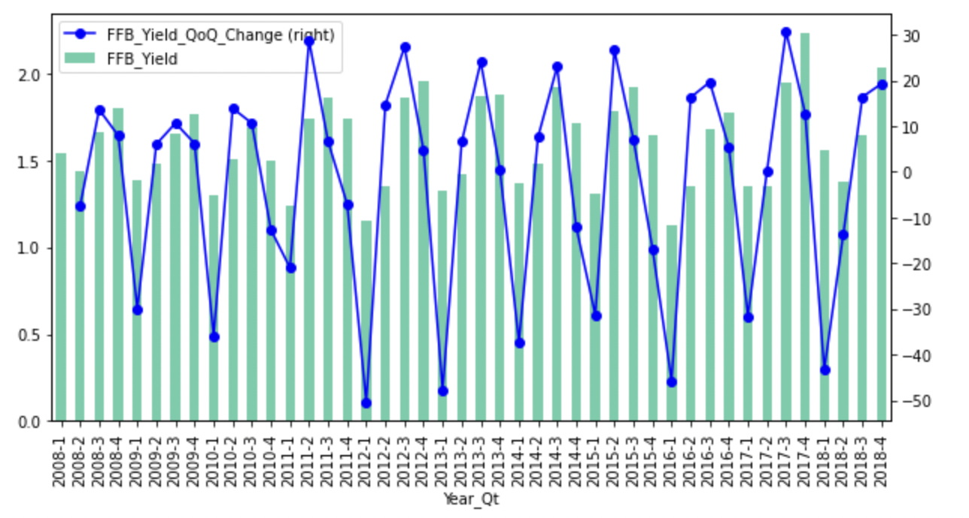
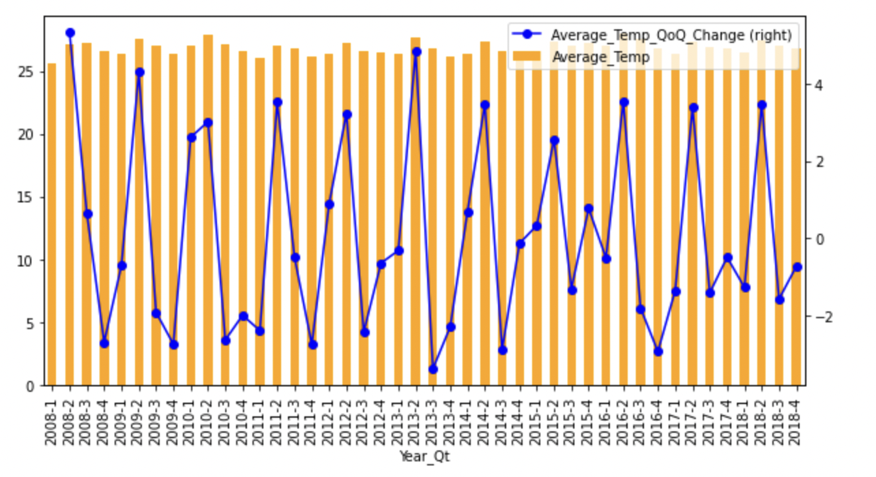
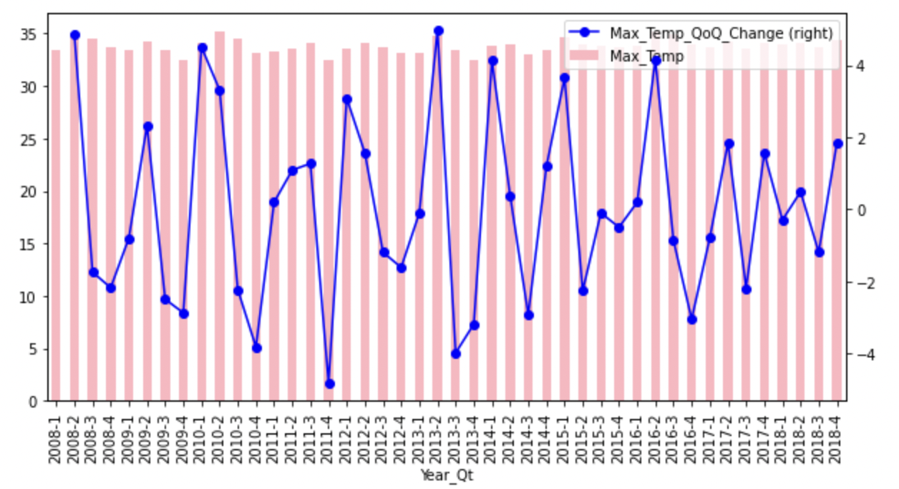
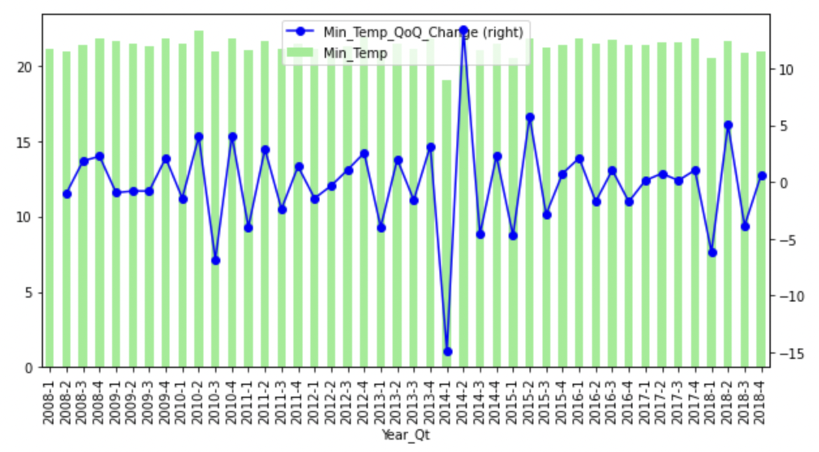
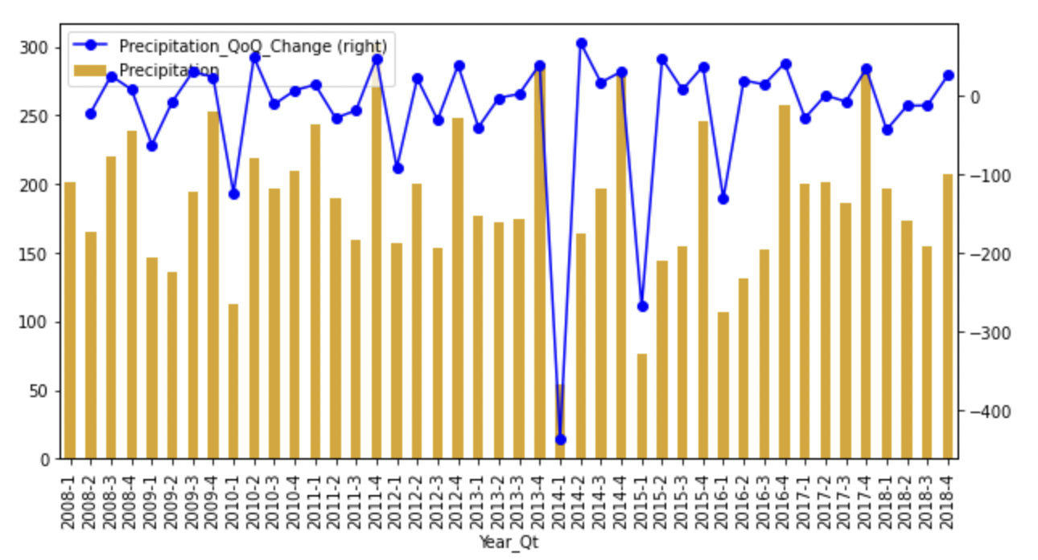
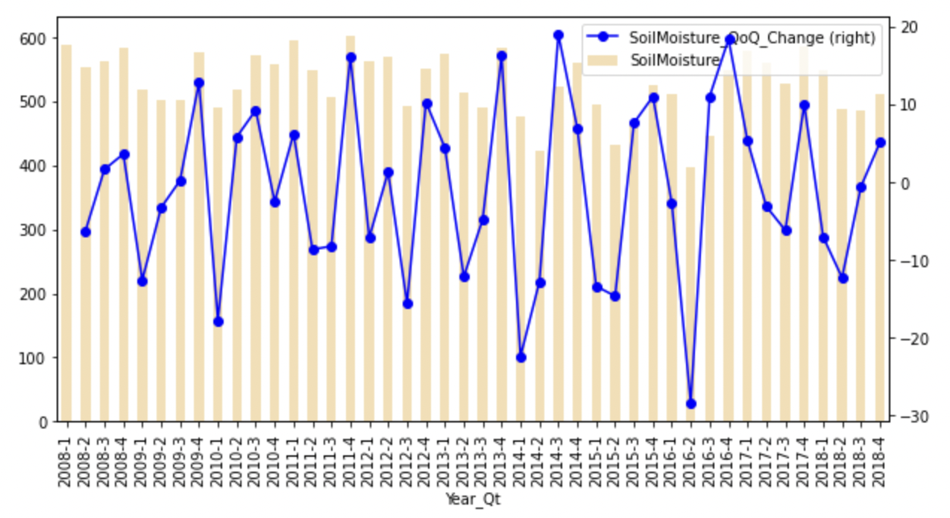
Historical Trend
Starting 2016, Q4 yields are consistently higher than Q3 yields. Whereas for 2010,2011, 2014 and 2015, Q4 yields are lower than Q3 yields
Starting Jan 2011, Q-o-Q variations in FBB yield are consistently higher as compared to the period between 2008 – 2010
Seasonality exists for FFB yield and rest of the other variables

Slide 17
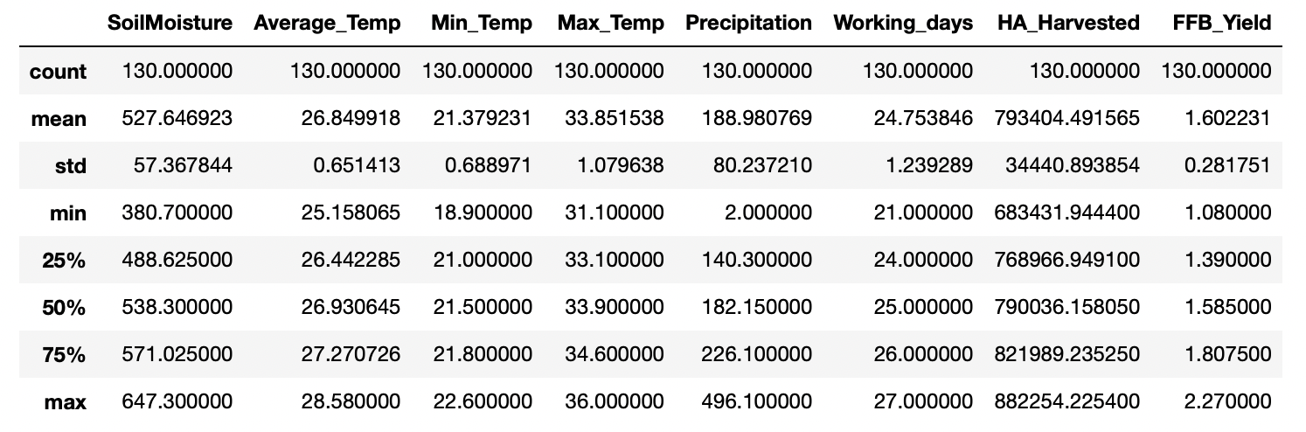
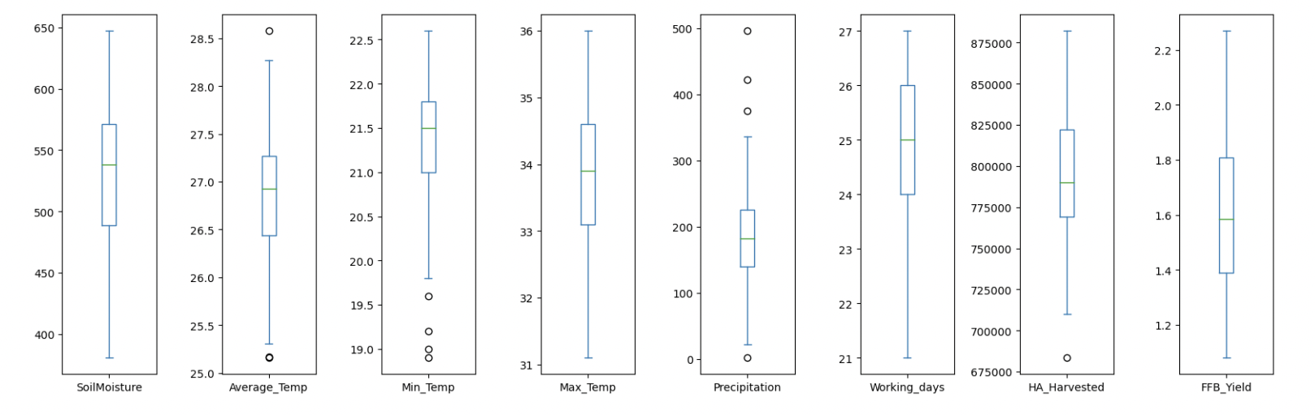
Descriptive Statistics
No missing data
All the variables are continuous
Unit of the variable differ significantly
SoilMoisture, Average_Temp, Min_Temp, Max_temp are left skewed
Precipitation and Working data are normally distributed
FFB_Yield and HA_Harvested right skewed
Average_temp, Min_temp and Precipitation have potential outliers based on +/- 1.5IQR rule

Slide 18
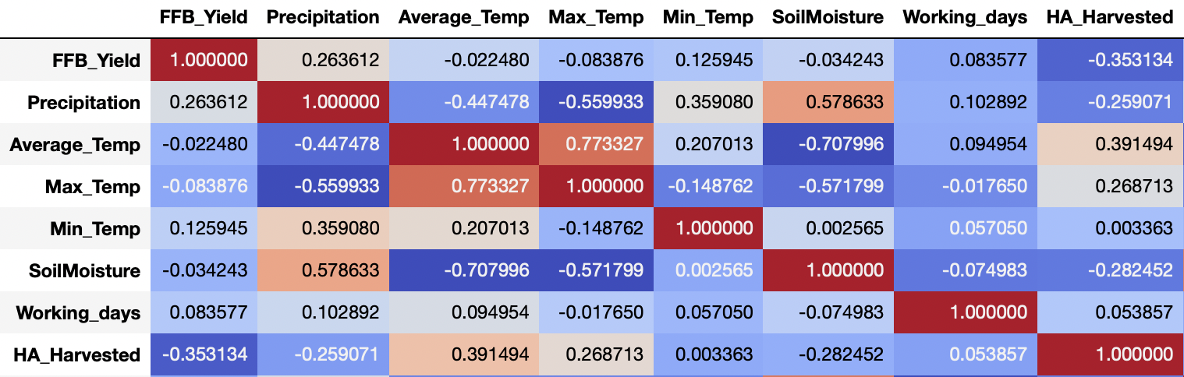
Correlation Plot
Since we want to understand the impact of individual variables on FFB yield, PCA or any other dimensionality reduction cannot be done
The next best option is to ignore one of the correlated variables

Slide 19
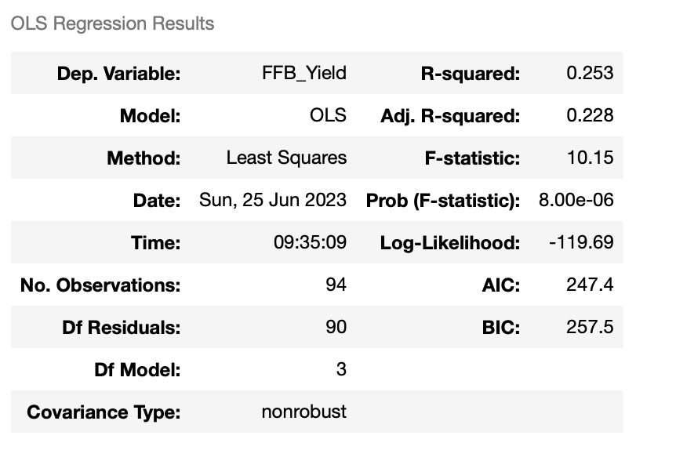

Model Results
Model A: Between 2011 and 2018
Model B: Between 2016 and 2018
Regression summary
Regression summary
Results for model B, which was run on data between 2016 and 2018, are better in terms of R-squared, AIC and BIC
Hence we will only take significant variables from model B to explain the relationship

Slide 20
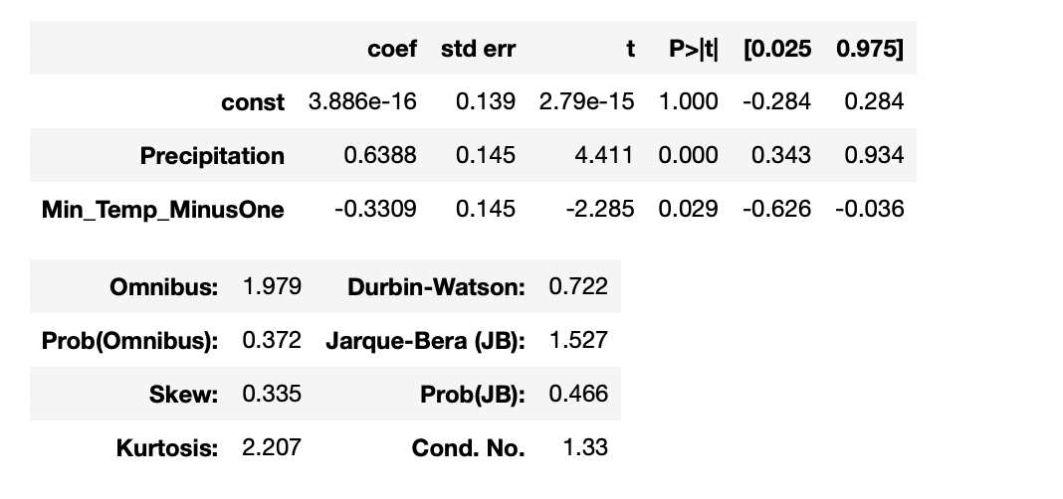
Significant Variables: Model B
Model B: Between 2016 and 2018

Slide 21
Relationship Between External Variables And FFB Yield
Attributes | FFB_Yield_Change | Description
Precipitation | 0.003 | One unit change in precipitation during the harvest month will result in 0.003 units increase in FFB_Yield
Min_Temp_MinusOne | -0.169 | One unit increase in minimum temperature a month before harvest will result in 0.169 units increase in FFB_Yield
FFB yield favors precipitation during the month of harvest (p value = 0.000115) and is negatively affected by increase in temperature a month before the harvest (p value = 0.0293)

Slide 22
Question 3

Slide 23
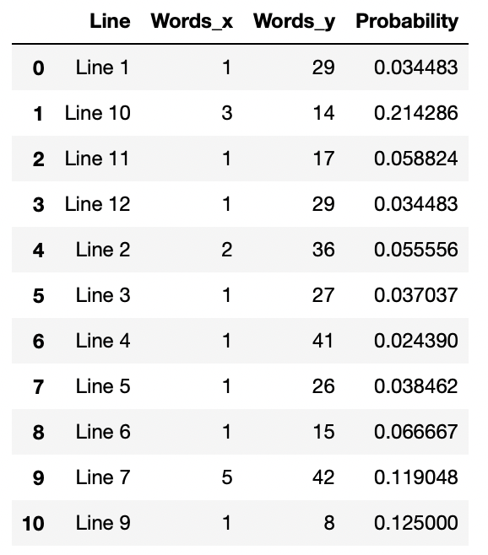
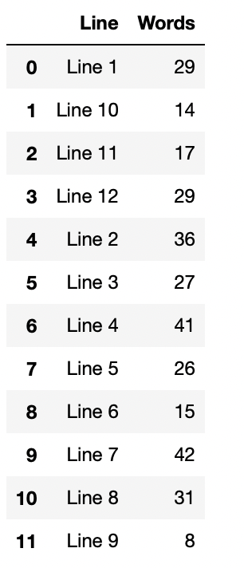
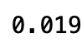
Results
Question 3.1
What is the distribution of distinct word counts across all the lines ?
What is the probability of the word “analytics” occurring after the word “data” ?
What is the probability of the word “data” occurring in each line ?
Question 3.2
Question 3.3

Slide 24
Thank You

